Slide 1


Slide 2
Module: Programming with Python
Lecturer: James HAKIZIMANA
Email: jhakizimana@uok.ac.rw
Phone: +250788697528

Slide 3
Outline of the lesson
Functions in python

Slide 4
Functions
A function is a reusable block of code that performs a specific task. Functions help make your code more organized, readable, and efficient.

Slide 5
Defining and calling a Function
Syntax
Example
def function_name():
# code block
Function name()
Def greet(): print(hello, welcome to python!“) Greet()
def: keyword to define a function
Function name: the name of the function
(): parentheses (can hold parameters)
: starts the function block
Indented block: the function body Function name(): it is to call a function
Output: Hello, welcome to python

Slide 6
A Function with parameters
Syntax
def function_name(parameter1,parameter2,….):
# code block
Function name(parameter1,parameter2,….)
Example
def greet(name,age): print(f"Hello, welcome {name} to Python!", end="") print(f"you are { age} ") greet("James",13)
output
Hello, Welcome James to Python! You are 13

Slide 7
A Function with Returning a Value
Syntax
Example
def function_name(param):
return value
def square_of_a_number(x):
return x * x
print(square_of_a_number(4))
Output: # Output: 16

Slide 8
A Function with a default argument
Syntax
def function_name(param=default_value):
# code block
Example
def greet_user(name="Guest"):
print(f"Hello, {name}!")
greet_user() # Output: Hello, Guest!
greet_user("Rwanda") # Output: Hello, Rwanda!

Slide 9
A Function with Keyword Arguments
Syntax
function_name(param1=value1, param2=value2)
Example
def order(food, drink):
print(f"You ordered {food} with {drink}.")
order("juice", "rice")
Output
you ordered rice with juice.

Slide 10
A Function Returning Multiple Values
Syntax
def function_name():
return value1, value2
Example
def math_operations(a, b):
return a + b, a - b, a * b
sum, difference, product= math_operations(5, 3)
print(add, sub, mul) # Output: 8 2 15
Output
8 2 15

Slide 11
Practice
Make a python program using function that will ask the user to enter the deposit amount, period and rate. Then your program should display or compute the simple interest.

Slide 12
Lambda Functions (Anonymous Functions)
Syntax
Function name=lambda arguments: expression
Example
Exercice:
Make a python program with lambda function with parameter age. Your program should return “ you are 23 years old. Where 23 is your age
squareofnumber = lambda x: x * x
print(squareofnumber(5)) # Output: 25
Output
25

Slide 13
Recursive Functions
A recursive function is one that calls itself.
def function_name():
# base case
# recursive call
Syntax
def factorial(n):
if n == 0:
return 1
else:
return n * factorial(n - 1)
print(factorial(5)) # Output: 120
Example 1
Output
: 120

Slide 14
Recursive Functions (cont’)
def fibonacci(n):
if n <= 1:
return n
else:
return fibonacci(n-1) + fibonacci(n-2)
for i in range(6):
print(fibonacci(i), end=" ") # Output: 0 1 1 2 3 5
Example 2
Output
0 1 1 2 3 5

Slide 15
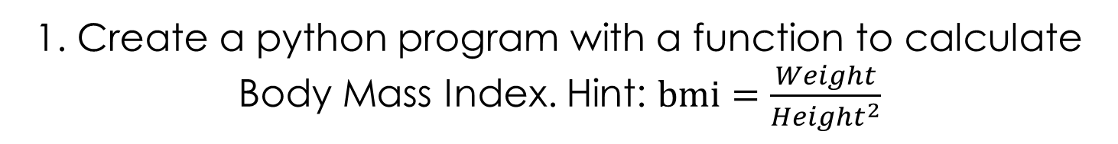
Exercices
1. Create a python program with a function to calculate Body Mass Index. Hint: $bmi=\frac{Weight}{{Height}^{2}}$
2.Make a python program that takes a list of marks of 5 modules and return average, highest, and grade.
3. Create a python program of Simple Interest Calculator using Lambda
4. Create a python program that asks a user to enter loan amount, monthly pay rate and payment period in months.
Then your program could track the remaining amount and showing the previous payments(amount remaining).

Slide 16
solution 1
def calculate_bmi(weight, height):
bmi = weight / (height ** 2)
return round(bmi, 2)
print(calculate_bmi(70, 1.75)) #
Output
Output: 22.86

Slide 17
def evaluate_grades(marks):
average = sum(marks) / len(marks)
highest = max(marks)
if average >= 90:
grade = "A"
elif average >= 80:
grade = "B"
elif average >= 70:
grade = "C"
else:
grade = "F"
return average, highest, grade
result = evaluate_grades([85, 78, 92])
print(result) # Output: (85.0, 92, 'B')
Solution 2

Slide 18
Solution 3
simple_interest = lambda p, r, t: (p * r * t) / 100
print(simple_interest(1000, 5, 3)) # Output: 150.0

Slide 19
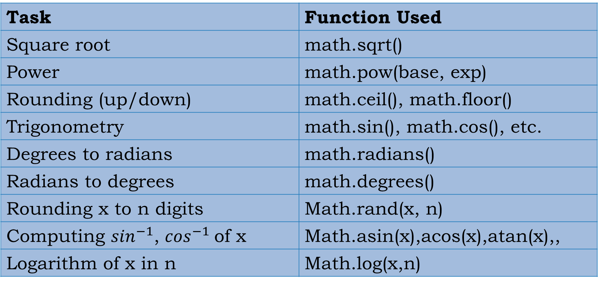
Before using math functions in python, first we have to import math module.
Task | Function Used
Square root | math.sqrt()
Power | math.pow(base, exp)
Rounding (up/down) | math.ceil(), math.floor()
Trigonometry | math.sin(), math.cos(), etc.
Degrees to radians | math.radians()
Radians to degrees | math.degrees()
Rounding x to n digits | Math.rand(x, n)
Computing $\sin^{−1}$, $\cos^{−1}$of x | Math.asin(x),acos(x),atan(x),,
Logarithm of x in n | Math.log(x,n)

Slide 20
Math functions: examples
import math deg=90 x=0.52 p=10 z=4.124 print(f"ceiling of {z} is { math.ceil(z)}") print(f"floor of {z} is { math.floor(z)}") print( f" {p} exponent { 4} is equal to {math.pow(p,4)}") print(f" logarithm of {81} in base {3} is {math.log(81,3) }") print(f" {deg} is equal to {math.radians(deg)} radians") print(f"arcsin of {x} is { (round(math.degrees( math.asin(x) ),2))} degrees")
Output
ceiling of 4.124 is 5
floor of 4.124 is 4
10 exponent 4 is equal to 10000.0
logarithm of 81 in base 3 is 4.0
90 is equal to 1.5707963267948966 radians
arcsin of 0.52 is 31.33 degrees

Slide 21
Exercices
1. About sin and cosine rules for any triangle
2. Area of triangle

Slide 22
Exercises
Write a Python program that collects the marks of a student in five modules:
Python, ICT, Cryptography,Operations Research and Linear Algebra. The program should:
Prompt the user to enter a mark for each of the five modules.
Calculate and display:
The average mark
The highest mark among the five and with the name of that module.
The overall grade, based on the average, using the grading scale below:
Validate that all marks entered are numeric and fall between 0 and 100.
Average Score | Grade
80 – 100 | A (Excellent)
70 – 79 | B (Very Good)
60 – 69 | C (Good)
50 – 59 | D (Pass)
Below 50 | F (Fail)

Slide 23


Slide 24
QUESTION & ANSWERS!

